Slide 1
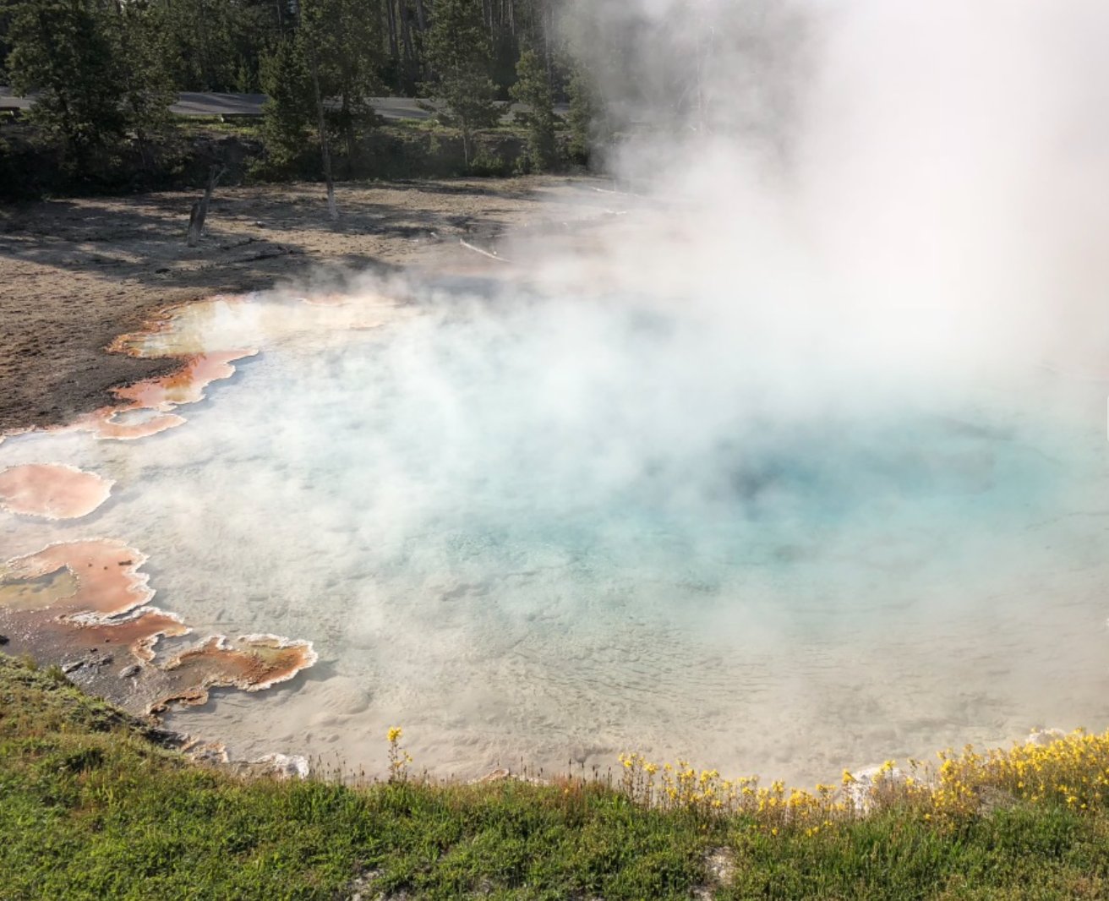
Hardest Unit ☹
Unit 9 – Inferences from Two Samples All Days
Your Bad Planning Professor Colton

Slide 2
Unit 9 - Outline
Unit 9 – Inferences from Two Samples
Intro
Hypothesis Testing Overview for Two Samples
Review all Steps
Hypothesis Testing of Two Population Proportions
Traditional and P-value Methods
Confidence Intervals
Hypothesis Testing of Two Population Means (Independent Samples)
Independent vs Dependent (Matched vs Paired)
Means of Independent Samples with sigma known, traditional and pvalue methods
Means of Independent Samples with sigma unknown, p-value method
Confidence Intervals

Slide 3
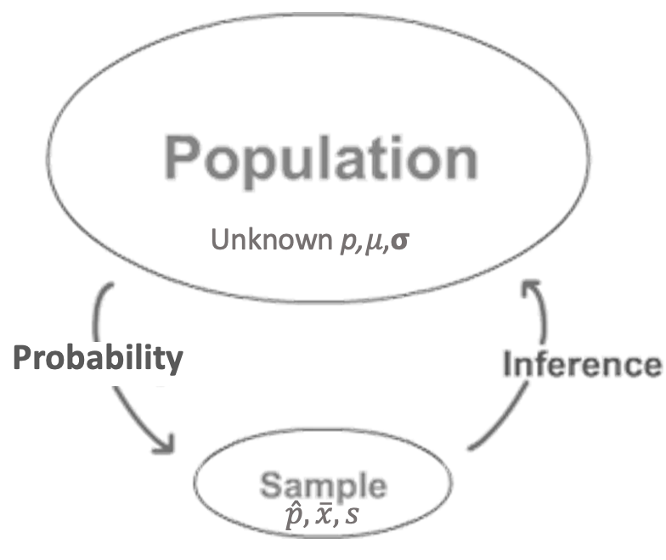
Inference! Our Third Look
Compare
1
2
?
=
≠
<
>

Slide 4
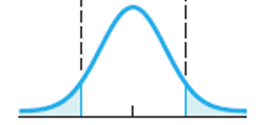
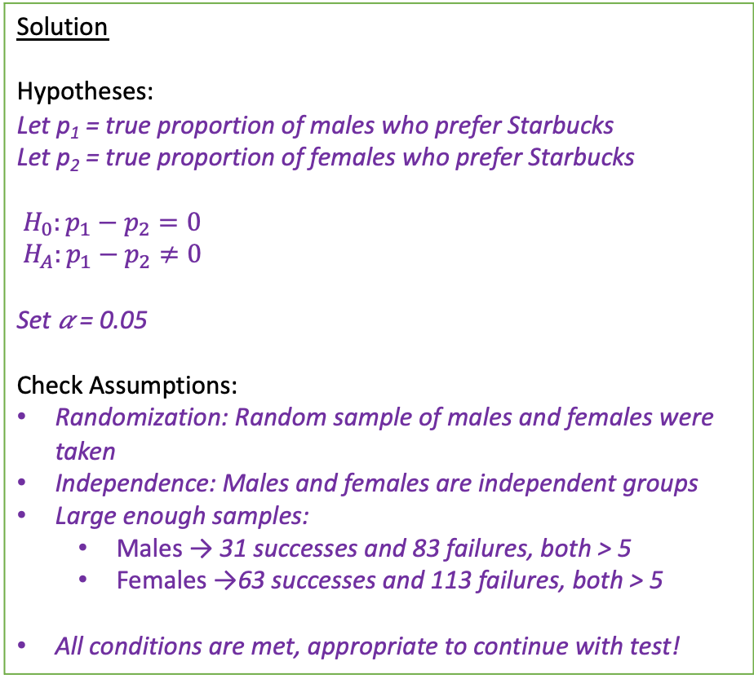
Full Problem
Here is an entire TWO sample hypothesis problem worked out perfectly to show us where we are going!
Then we will break it down piece by piece again!
Setup: Is there a difference in the proportion of male and female college students who prefer Starbucks as their favorite coffee spot? We collected data from random samples of students from CSCC and found that 31 out of 114 males and 63 out of 176 females prefer Starbucks. Test an appropriate hypothesis with α = 0.05.
Solution
Hypotheses:
Let p₁ = true proportion of males who prefer Starbucks
Let p₂ = true proportion of females who prefer Starbucks
$H_{0}:p_{1}−p_{2}=0$
$H_{A}:p_{1}−p_{2}≠0$
Set 𝛼 = 0.05
Check Assumptions:
Randomization: Random sample of males and females were taken
Independence: Males and females are independent groups
Large enough samples:
Males → 31 successes and 83 failures, both > 5
Females →63 successes and 113 failures, both > 5
All conditions are met, appropriate to continue with test!
Rejection Region:
Z* = invNorm(area = 0.05/2, 𝜇 = 0, 𝞂 = 1) = -1.96
Test Statistic:
TS = Z_{stat} = 2–PropZTest(x₁ = 31, n₁ = 114, x₂ = 63, n₂ = 176, p₁ ≠ p₂) = -1.529
|Z_{stat}| = 1.529 < 1.96 = |Z*| → Fail to reject H₀
Conclusion and Interpretation:
Because the absolute value our Test Statistic Z_{stat} = 1.529 is less than the absolute value of the Critical Value Z*= 1.96 (5% significance level), we fail to reject the Null hypothesis. We do NOT have sufficient evidence to conclude that the true proportion of male college students who prefer Starbucks is different than that of females.
0.025 = 𝛼/2
𝛼/2 = 0.025
Z* = -1.96
Z* = 1.96
Z_{stat}

Slide 5
Hypothesis Test Steps – Reminder
State the Hypotheses
Define parameter + context.
Check Assumptions.
Determine and Sketch Rejection Region based of Significance Level
Compute value of Test Statistic / P-value.
Conclude and Interpret
State whether you reject H₀ or fail to reject H₀ AND WHY!
Interpret your results in the context of the problem

Slide 6
The Hypothesis Statements – Two Samples
State the Hypotheses
Define parameter + context.
Full Example
Is there a difference in the proportion of male and female college students who prefer Starbucks as their favorite coffee spot? Test an appropriate hypothesis.
Parameters:
Let p₁ = true proportion of males who prefer Starbucks
Let p₂ = true proportion of females who prefer Starbucks
Define Parameters
Now we have TWO populations and TWO parameters!
These parameters describe the same quantity (ex: ‘true proportion who prefer Starbucks’) BUT for different groups (ex: males vs females)!
So we have to CLEARLY define both of them!
Using subscripts of 1 and 2 will be helpful because that is the notation we will use for the calculations and calculator!
Order matters and will be important when making our conclusions!

Slide 7
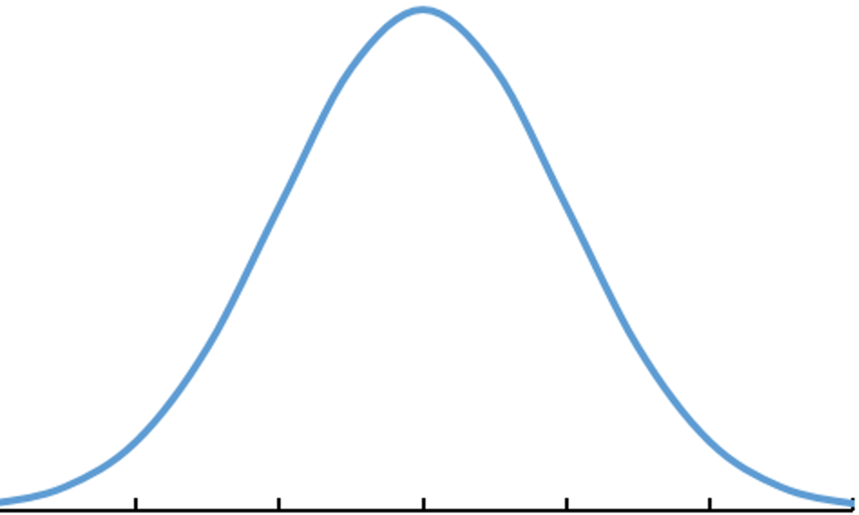
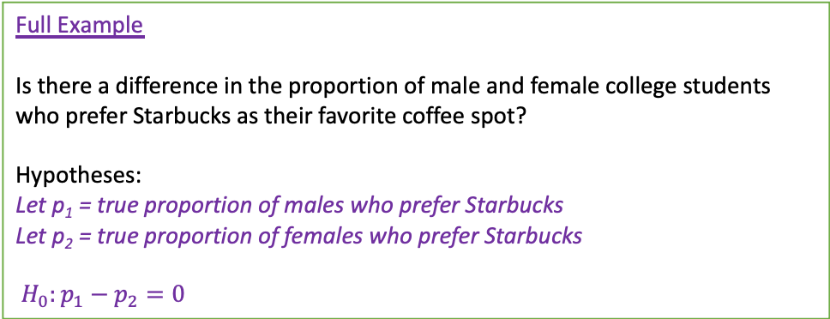
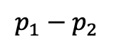
The Hypothesis Statements – Two Samples
State the Hypotheses
Define parameter + context.
Full Example
Is there a difference in the proportion of male and female college students who prefer Starbucks as their favorite coffee spot?
Hypotheses:
Let p₁ = true proportion of males who prefer Starbucks
Let p₂ = true proportion of females who prefer Starbucks
$H_{0}:p_{1}−p_{2}=0$
Null Hypothesis H₀
Now we are comparing some quantity (the same quantity) between TWO populations! So we have TWO parameters!
We are not necessarily interested in the specific values of these parameters like we were when testing ONE sample (ex: H₀: p = p₀)
Rather we want to learn about the relationship between the two of them, p₁ ?? p₂
We start by assuming both parameters are equivalent! So their difference is ZERO!
This can be written in two ways!
Option 1
Directly equating the two parameters:
H₀: p₁ = p₂
H₀: µ₁ = µ₂
** Can think of these as a new population of DIFFERENCES!
-0.15 -0.10 -0.05 0 0.05 0.10 0.15
-3 -2 -1 0 1 2 3
Option 2
Rewrite as a difference!
H₀: p₁ - p₂ = 0
H₀: µ₁ - µ₂ = 0
Writing our Null hypothesis in this way helps us visualize the Normal curves we use for the CV and TS
This is an equivalent way to represent it, just a change in perspective to the DIFFERENCE (a single value)
$$p_{1}−p_{2}$$
Z
Standardize

Slide 8
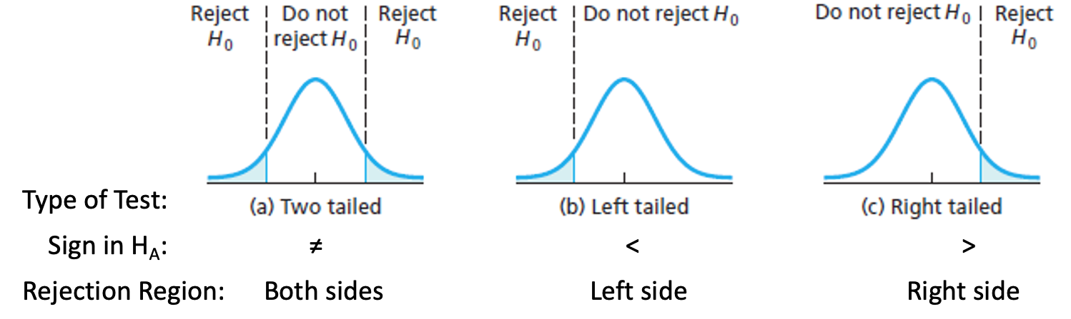
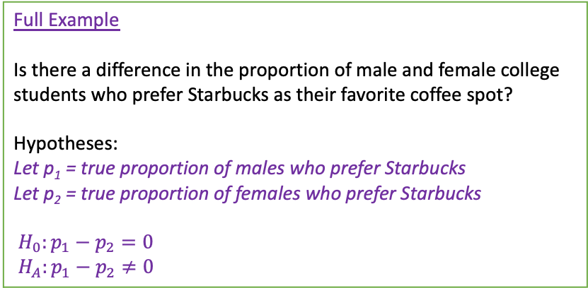
The Hypothesis Statements – Two Samples
State the Hypotheses
Define parameter + context.
Full Example
Is there a difference in the proportion of male and female college students who prefer Starbucks as their favorite coffee spot?
Hypotheses:
Let p₁ = true proportion of males who prefer Starbucks
Let p₂ = true proportion of females who prefer Starbucks
$H_{0}:p_{1}−p_{2}=0$
$H_{A}:p_{1}−p_{2}≠0$
Alternative Hypothesis H_{A}
Here is where we state our research interest.
Again, we are interested in the relationship between our two parameters and how we think they are different
Our test on the single value of the difference may be left-tailed (<), right-tailed (>), or two-tailed (≠).
Alternative can also be written in two ways:
Option 1 Option 2
H_{A}: p₁ ≠ p₂ → p₁ - p₂ ≠ 0
H_{A}: p₁ > p₂ → p₁ - p₂ > 0
H_{A}: p₁ < p₂ → p₁ - p₂ < 0
(same for µ₁ and µ₂)

Slide 9
LCQ – Hypotheses
Problem: (1) Define the parameters of interest and (2) State the Null and Alternative for the following scenarios:
a) A company has two separate teams (A and B) who complete accounting reports. From a random sample of recent reports from each team, they want to know if these teams perform differently in terms of proportion of reports completed on time.
b) A company randomly selects employees to complete yearly surveys on whether or not they enrolled in at least one wellness class at the company’s site. They want to know if a greater percentage took a wellness class this year compared to last year.

Slide 10
LCQ – Hypotheses
Problem: (1) Define the parameters of interest and (2) State the Null and Alternative for the following scenarios:
a) A company has two separate teams (A and B) who complete accounting reports. From a random sample of recent reports from each team, they want to know if these teams perform differently in terms of proportion of reports completed on time.
Let p₁ = the true proportion of completed accounting reports from team A
Let p₂ = the true proportion of completed accounting reports from team B
H₀: p₁ - p₂ = 0 OR H₀: p₁ = p₂
H_{A}: p₁ - p₂ ≠ 0 OR H_{A}: p₁ ≠ p₂
Perfect! Both versions are correct, there are just different benefits to each!
The difference version (first way) helps us when looking at the result of our TS, but our calculator uses the direct comparison (second way) in the menus
b) A company randomly selects employees to complete yearly surveys on whether or not they enrolled in at least one wellness class at the company’s site. They want to know if a greater percentage took a wellness class this year compared to last year.
Let p₁ be the true proportion of employees enrolled in at least one wellness class THIS YEAR → Correct! THIS YEAR is our first group, that is the first population
Let p₂ be the true proportion of employees that did not enrolled in at least one wellness class → INCORRECT! Because this is now representing a different quantity than in p₁ ₍ (enrolled vs did NOT enroll); the only thing that should change is the GROUP!
Let p₂ be the true proportion of employees enrolled in at least one wellness class LAST YEAR →Good! LAST YEAR is our second group, now our parameter is for the same quantity but a different POPULATION
H₀: p₁ - p₂ = 0
H_{A}: p₁ - p₂ > 0
Very good!
What if switch the order of our parameters? Now let:
p₁ = LAST year
p₂ = THIS year
H₀: p₁ - p₂ = 0 → same
H_{A}: p₁ - p₂ < 0 → different! We still want this year to be greater, so now p₂ is the larger value making the difference less than zero! Order is important

Slide 11
Assumptions
Full Example
Is there a difference in the proportion of male and female college students who prefer Starbucks as their favorite coffee spot?
They random samples of students from CSCC and found that 31 out of 114 males and 63 out of 176 females prefer Starbucks
Check Assumptions:
Randomization: Random sample of males and females was taken
Independence: Males and females are independent groups
Large enough samples:
Males → 31 successes and 83 failures, both > 5
Females →63 successes and 113 failures, both > 5
All conditions are met, appropriate to continue with test!
2. Check Assumptions.
For the most part this step is the same as we have seen before!
Random Sample and Large enough sample
How we check the Large enough sample assumption depends on the type of test (type of data)
We just have to do it for both samples now!
Although now we also have to think about the connection between our two samples
Will go over these again when looking at Proportions Tests and Means Tests
* will go through these with the proportions slide

Slide 12

Rejection Region and TS – Two Samples
3. Determine and Sketch Rejection Region based of Significance Level
Full Example
Is there a difference in the proportion of male and female college students who prefer Starbucks as their favorite coffee spot?
Rejection Region:
Set 𝛼 = 0.05 (which was set at beginning)
Z* = invNorm(area = 0.05/2, 𝜇 = 0, 𝞂 = 1) = -1.96
Test Statistic:
TS = Z_{stat} = 2–PropZTest(x₁ = 31, n₁ = 114, x₂ = 63, n₂ = 176, p₁ ≠ p₂) = -1.529
|Z_{stat}| = 1.529 < 1.96 = |Z*| → Fail to reject H₀
P-Value:
p-value = 2–PropZTest(x₁ = 31, n₁ = 114, x₂ = 63, n₂ = 176, p₁ ≠ p₂) = 0.126
Rejection Region (RR)
This is the EXACT same as we have seen in all the other types of tests!
Which is because we are framing our tests from the perspective of a difference!
0.025 = 𝛼/2
𝛼/2 = 0.025
p-value = 0.126
Z* = -1.96
Z* = 1.96
4. Compute value of Test Statistic / P-value.
Z_{stat}
Test Statistic (TS) and P-Value
SAME logic as with one sample, just different calculations behind the scenes
Will go over the specifics on each respective Test’s slides

Slide 13
Conclude and Interpret – Two Samples
5. Conclude and Interpret
State whether you reject H₀ or fail to reject H₀ AND WHY!
Interpret your results in the context of the problem
Full Example
Is there a difference in the proportion of male and female college students who prefer Starbucks as their favorite coffee spot?
Conclusion and Interpretation:
Because
the absolute value of our Test Statistic |Z_{stat}| = 1.529 is less than the Critical Value Z* = 1.69 (5% significance level)
OR
our p-value = 0.126 is greater than the significance level 0.01
We do have sufficient evidence to conclude that the true proportion of male college students who prefer Starbucks is different than that of females.
This has the SAME structure that we had with ONE sample Hypothesis Tests
We just need to talk about BOTH parameters for the Alternative!
First Part – Decision and Reasoning
Because (comparison of TS and CV; OR p-value and 𝛼) we (REJECT or FAIL TO REJECT) the Null Hypothesis.
Second Part – Interpretation
There (IS or IS NOT) sufficient evidence to conclude (THE ALTERNATIVE HYPOTHESIS + CONTEXT).
NOTE about wording!
When thinking about the alternative as a difference (very literally), our wording could be something similar to ”There is / is not sufficient to conclude the true difference in proportion of males who prefer Starbucks and of females is not equal to (or less / greater than) zero.”
This doesn’t read very well and it’s not how we would talk about the results in conversation. So try and reword it as a direct comparison of the two population parameters like it is in the example (not in terms of the difference and zero)!
** Give MORE INFORMATION IF POSSIBLE
If REJECT a two-tailed test, say which of the parameters is larger!
Just look at the sign of the TS and the order of our Hypotheses!
Ex) If conclude H_{A}: p₁ - p₂ ≠ 0 and TS = 2.3 → p₁ > p₂ , so say this in our interpretation!

Slide 14
Hypothesis Tests for Proportions – Two Samples!
Everything above applies, now we are just going to apply it specifically to a Two Sample Proportions Test!

Slide 15
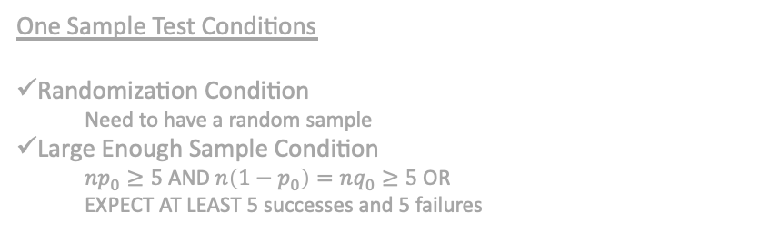
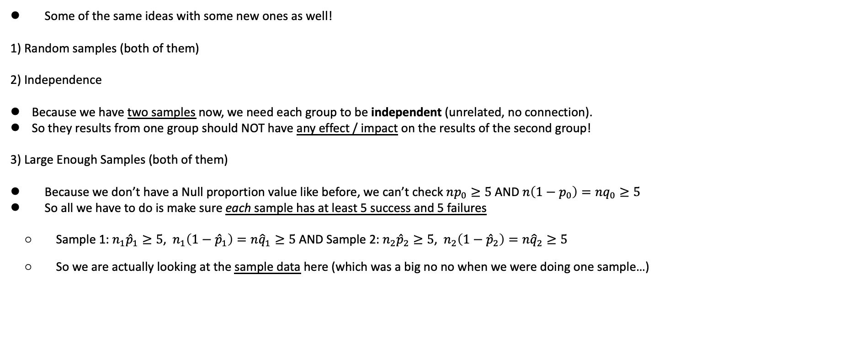
Proportions Assumptions- Two Samples
Full Example
Is there a difference in the proportion of male and female college students who prefer Starbucks as their favorite coffee spot?
They random samples of students from CSCC and found that 31 out of 114 males and 63 out of 176 females prefer Starbucks
Check Assumptions:
Randomization: Random sample of males and females was taken
Independence: Males and females are independent groups
Large enough samples:
Males → 31 successes and 83 failures, both > 5
Females → 63 successes and 113 failures, both > 5
All conditions are met, appropriate to continue with test!
2. Check Assumptions.
Some of the same ideas with some new ones as well!
1) Random samples (both of them)
2) Independence
Because we have two samples now, we need each group to be independent (unrelated, no connection).
So they results from one group should NOT have any effect / impact on the results of the second group!
3) Large Enough Samples (both of them)
Because we don’t have a Null proportion value like before, we can’t check $np_{0}≥5$ AND $n\left(1−p_{0}\right)=nq_{0}≥5$
So all we have to do is make sure each sample has at least 5 success and 5 failures
Sample 1: $n_{1}{\hat{p}}_{1}≥5$, $n_{1}\left(1−{\hat{p}}_{1}\right)=n{\hat{q}}_{1}≥5$ AND Sample 2: $n_{2}{\hat{p}}_{2}≥5$, $n_{2}\left(1−{\hat{p}}_{2}\right)=n{\hat{q}}_{2}≥5$
So we are actually looking at the sample data here (which was a big no no when we were doing one sample…)
One Sample Test Conditions
Randomization Condition
Need to have a random sample
Large Enough Sample Condition
$np_{0}≥5$ AND $n\left(1−p_{0}\right)=nq_{0}≥5$ OR
EXPECT AT LEAST 5 successes and 5 failures
TWO Sample Test Conditions
Randomization Condition
Need to have two random samples
Independence Condition
Need to independent samples
Large Enough Sample Condition
AT LEAST 5 successes and 5 failures in EACH collected sample
New conditions

Slide 16
LCQ – Assumptions
Problem: Check the conditions for a Hypothesis Test of the two population proportions for the following scenarios:
a) A company has two separate teams (A and B) who complete accounting reports. From a random sample of 50 recent reports from each team, 40% of Team A’s were on time and 36% of Team B’s were on time. They want to know if these teams perform differently in terms of proportion of reports completed on time.
b) A company randomly selects employees to complete yearly surveys on whether or not they enrolled in at least one wellness class at the company’s site. Last year’s survey showed 81 out of 100 employees had taken a wellness class and this year 102 out of 140 had. They want to know if a greater percentage took a wellness class this year compared to last year.

Slide 17
LCQ – Assumptions
Problem: Check the conditions for a Hypothesis Test of the two population proportions for the following scenarios:
a) A company has two separate teams (A and B) who complete accounting reports. From a random sample of 50 recent reports from each team, 40% of Team A’s were on time and 36% of Team B’s were on time. They want to know if these teams perform differently in terms of proportion of reports completed on time.
1) Random condition: ‘Random sample of 50 reports from each team’ Yes! → Have random sample from both groups
2) Independence condition: Separate teams so independent, Yes!! → No reason to think these separate teams impact each other
3) Large enough samples condition: Yes! → Using sample proportions to check these below
Team A: 50(.4) = 20 > 5 and 50(.6) = 30 > 5
Team B: 50(.36) = 18 > 5 and 50(.64) = 32 > 5
ALL conditions are met! Okay to continue with test!
b) A company randomly selects employees to complete yearly surveys on whether or not they enrolled in at least one wellness class at the company’s site. Last year’s survey showed 81 out of 100 employees had taken a wellness class and this year 102 out of 140 had. They want to know if a greater percentage took a wellness class this year compared to last year.
1) Random condition: Company randomly selects individuals to complete the surveys each year, Yes!
2) Independence condition: Surveys from different years, Yes! → No reason to think one wellness class enrollment depends on which year it was. And we are not the selecting same people because of randomness
3) Large enough samples condition: Yes! → Can directly use the given sample results (no need to get the proportions first) to check these below
This year: 102 successes and 38 failures, both > 5
Last year: 81 successes and 19 failures, both > 5
ALL conditions are met! Okay to continue with test!

Slide 18
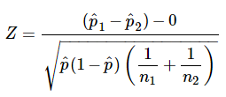
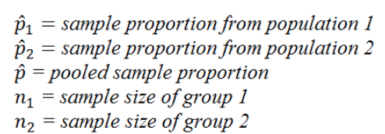
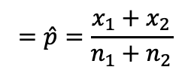
Using Calc - Test Statistic and P-Value for Proportions
https://www.statisticshowto.com/probability-and-statistics/hypothesis-testing/z-test/
https://www.six-sigma-material.com/Proportions-Tests.html
4. Compute value of Test Statistic / P-value.
Formula for Z_{stat} by hand:
Setup
A NatGeo Poll interviewed 1200 hiking enthusiasts and 1100 climbers. They asked “Are you more afraid of spiders or snakes???” 768 of the 1200 hikers and 662 of the 1100 climbers, responded “Ewww, snakes….” Is there enough evidence to conclude the proportion of hikers who are more afraid of snakes is different than that of climbers? Use 𝛼 = 0.1
GOAL: Conduct a Hypothesis Test!
2–PropZTest
x₁ = number of successes in sample 1
n₁ = sample size 1
x₂ = number of successes in sample 2
n₂ = sample size 2
p₁: Alternative hypothesis with p₂ → ** NOTE this is not in terms of the difference
Calculate or Draw
Combined (“pooled”) sample proportion
(no subscript)
$$=\hat{p}=\frac{x_{1}+x_{2}}{n_{1}+n_{2}}$$

Slide 19
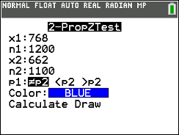
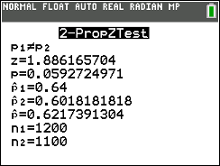
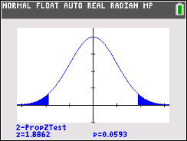
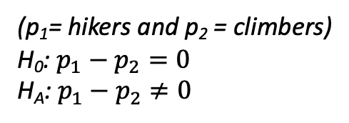
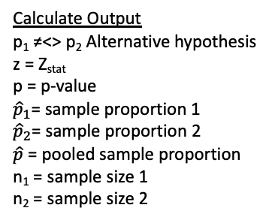
Using Calc - Test Statistic and P-Value for Proportions
https://www.statisticshowto.com/probability-and-statistics/hypothesis-testing/z-test/
https://www.six-sigma-material.com/Proportions-Tests.html
4. Compute value of Test Statistic / P-value.
Formula for Z_{stat} by hand:
Setup
A NatGeo Poll interviewed 1200 hiking enthusiasts and 1100 climbers. They asked “Are you more afraid of spiders or snakes???” 768 of the 1200 hikers and 662 of the 1100 climbers, responded “Ewww, snakes….” Is there enough evidence to conclude the proportion of hikers who are more afraid of snakes is different than that of climbers? Use 𝛼 = 0.1
GOAL: Conduct a Hypothesis Test!
2–PropZTest
x₁ = number of successes in sample 1
n₁ = sample size 1
x₂ = number of successes in sample 2
n₂ = sample size 2
p₁: Alternative hypothesis with p₂ → ** NOTE this is not in terms of the difference
Calculate or Draw
Combined (“pooled”) sample proportion
(no subscript)
$$=\hat{p}=\frac{x_{1}+x_{2}}{n_{1}+n_{2}}$$
Calculate Output
p₁ ≠<> p₂ Alternative hypothesis
z = Z_{stat}
p = p-value
${\hat{p}}_{1}$= sample proportion 1
${\hat{p}}_{2}$= sample proportion 2
$\hat{p}$ = pooled sample proportion
n₁ = sample size 1
n₂ = sample size 2
Draw Output
Plot (and displays values) of p = p-value and z = Z_{stat} on the standard normal curve
(p₁= hikers and p₂ = climbers)
H₀: $p_{1}−p_{2}=0$
H_{A}: $p_{1}−p_{2}≠0$

Slide 20
LCQ – Conclusions and Interpretations
5. Conclude and Interpret
State whether you reject H₀ or fail to reject H₀ AND WHY!
Interpret your results in the context of the problem
Problem: Write the conclusions and interpretations for the previous scenarios using our results.
Setup: A NatGeo Poll interviewed 1200 hiking enthusiasts and 1100 climbers. They asked “Are you more afraid of spiders or snakes???” 768 of the 1200 hikers and 662 of the 1100 climbers, responded “Ewww, snakes….” Is there enough evidence to conclude the proportion of hikers who are more afraid of snakes is different than that of climbers? Use 𝛼 = 0.1
Solution:

Slide 21
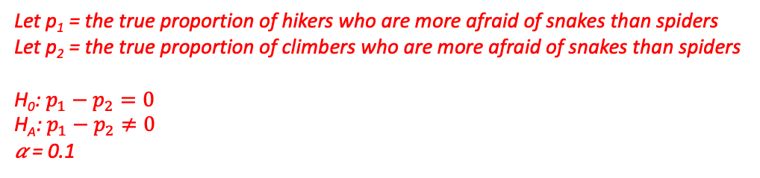
LCQ – Conclusions and Interpretations
5. Conclude and Interpret
State whether you reject H₀ or fail to reject H₀ AND WHY!
Interpret your results in the context of the problem
Problem: Write the conclusions and interpretations for the previous scenarios using our results.
Setup: A NatGeo Poll interviewed 1200 hiking enthusiasts and 1100 climbers. They asked “Are you more afraid of spiders or snakes???” 768 of the 1200 hikers and 662 of the 1100 climbers, responded “Ewww, snakes….” Is there enough evidence to conclude the proportion of hikers who are more afraid of snakes is different than that of climbers? Use 𝛼 = 0.1
Solution:
Need these…
Let p₁ = the true proportion of hikers who are more afraid of snakes than spiders
Let p₂ = the true proportion of climbers who are more afraid of snakes than spiders
H₀: $p_{1}−p_{2}=0$
H_{A}: $p_{1}−p_{2}≠0$
𝛼 = 0.1
P-Value
P-value = 2–PropZTest(x₁ = 768, n₁ = 1200, x₂ = 662, n₂ = 1100, p₁ ≠ p₂) = 0.0593
p-value = 0.0593 < 0.10 = 𝛼 → Reject H₀!
Conclusion and Interpretation
Because our p-value = 0.0593 is less than the significance level 0.10, we reject the Null hypothesis.
There IS sufficient evidence to conclude that the true proportion of hikers who are more afraid of snakes than spiders is different than that of climbers.
Further we can say that hikers’ proportion is actually greater (Z_{stat} = 1.89).
First part →
Second part →
More info →

Slide 22
Hypothesis Tests for Means – INDEPENDENT Samples (and Known 𝞂)
All of the previous Hypothesis tests overview applies, now we are just going to apply it specifically to a Two Sample Means Test!
And going back to the One Sample Means Test, we still have to determine if the population standard deviation is known or unknown.
This tells us if we are doing a Z distribution based Test or a T distribution based Test!
Now we have to also think about the relationship between our two population data sources → This section is for independent samples!
And we will start with KNOWN population standard deviations 𝞂₁ and 𝞂₂

Slide 23
LCQ: Independent vs Dependent Samples
How to think about samples
Independent samples → Groups are unrelated, no connection, no relationship
Dependent samples → Groups have some relationship between one another, can link the two; PAIRS
Problem: Determine if the following scenarios are independent or dependent samples.
1) Comparing the blood pressure of STAT 1450 students before the final exam and after completing the final exam.
2) Seeing if the height of Faculty is shorter than the undergraduate population.
3) Looking to see if there is a difference in the price of the same Video Game Consoles at Target or Walmart.
4) A study is conducted to see what effect a new drug has on dexterity. A random sample of 30 students is chosen. They are given a series of tasks to perform and a score reflecting their performance. A dose of the drug is given to the 30 students and they again perform similar tasks and are scored again.

Slide 24
LCQ: Independent vs Dependent Samples
How to think about samples
Independent samples → Groups are unrelated, no connection, no relationship
Dependent samples → Groups have some relationship between one another, can link the two; PAIRS
Problem: Determine if the following scenarios are independent or dependent samples.
1) Comparing the blood pressure of STAT 1450 students before the final exam and after completing the final exam.
Dependent! → There is a relationship between the blood pressure before the final and after the completion of the final. Connection is measuring the SAME student twice
2) Seeing if the height of Faculty is shorter than the undergraduate population.
Independent → There is no direct connection (or inherent relationship) between faculty and undergrads
3) Looking to see if there is a difference in the price of the same Video Game Consoles at Target or Walmart.
Independent??? Two different stores
Dependent! → No relationship between Target and Walmart, BUT we are looking at the SAME console at the two different stores (groups). So there is a relationship with the consoles (think pairs of X-boxes, one at Walmart and one at Target; same for a PS4)
4) A study is conducted to see what effect a new drug has on dexterity. A random sample of 30 students is chosen. They are given a series of tasks to perform and a score reflecting their performance. A dose of the drug is given to the 30 students and they again perform similar tasks and are scored again.
Dependent → SAME students before and after drug. So there is a relationship between the two groups

Slide 25
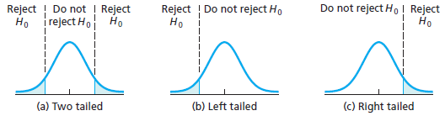
The Hypothesis Statements for Two Samples - Review
State the Hypotheses
Define parameter + context.
** Can think of these as a new population of DIFFERENCES!
Define Parameters
Now we have TWO populations and TWO parameters!
These describe the same quantity, just for different groups!
Quantitative (numeric) → population means 𝜇₁ and 𝜇₂
Null Hypothesis H₀
We want to learn about the relationship between the two of them, µ₁ ?? µ₂
So start by assuming both parameters are equivalent! So their difference is ZERO!
Alternative Hypothesis H_{A}
This is where we state how we think these means are different
Our test on the single value of the difference may be left-tailed (<), right-tailed (>), or two-tailed (≠).
-30 -20 -10 0 10 20 30
-3 -2 -1 0 1 2 3
𝜇₁ - 𝜇₂
Z
Standardize
How to write hypotheses
These can be written in two ways
Difference OR Direct Comparison
H₀: µ₁ - µ₂ = 0 H₀: µ₁ = µ₂
H_{A}: µ₁ - µ₂ ≠ 0 H_{A}: µ₁ ≠ µ₂
H_{A}: µ₁ - µ₂ < 0 H_{A}: µ₁ < µ₂
H_{A}: µ₁ - µ₂ > 0 H_{A}: µ₁ > µ₂
Type of Test:
Sign in H_{A}: ≠ < >
Critical Values: -Z* +Z* -Z* Z*

Slide 26
LCQ – Two Sample Means Hypotheses
Problem: (1) Define the parameters of interest and (2) State the Null and Alternative for the following scenarios:
a) A researcher random sampled 15 infants and 20 toddlers to measure their body temperatures. Let’s assume that body temperatures for all persons are normally distributed with some known standard deviation. Is there sufficient evidence to conclude that the mean body temperatures for infants and toddlers differ?
b) A prospective home buyer is trying to decide which city to move to. In Washington D.C, a random sample of 32 foreclosed homes sold for an average of $443,705 and in Baltimore and random sample of 45 foreclosed homes sold for $450,000. Real estate experts say the standard deviation for sales across the nation is $190,000. Is there sufficient evidence that the Baltimore housing market is more expensive?

Slide 27
LCQ – Two Sample Means Hypotheses
Problem: (1) Define the parameters of interest and (2) State the Null and Alternative for the following scenarios:
a) A researcher randomly sampled 15 infants and 20 toddlers to measure their body temperatures. Let’s assume that body temperatures for all persons are normally distributed with some known standard deviation. Is there sufficient evidence to conclude that the mean body temperatures for infants and toddlers differ?
Define Parameters
Let µ₁ = The TRUE mean body temperature of infants
Let µ₂ = The POPULATION mean body temperature of toddlers
Hypotheses
H₀: µ₁ = µ₂ OR H₀: µ₁ - µ₂ = 0 → Both CORRECT!
H_{A}: µ₁ ≠ µ₂ OR H_{A}: µ₁ - µ₂ ≠ 0 → CORRECT! We just want in to be different, not only interested in less than or greater than
b) A prospective home buyer is trying to decide which city to move to. In Washington D.C, a random sample of 32 foreclosed homes sold for an average of $443,705 and in Baltimore and random sample of 45 foreclosed homes sold for $450,000. Real estate experts say the standard deviation for sales across the nation is $190,000. Is there sufficient evidence that the Baltimore housing market is more expensive?
Define Parameters
Let P₁ = The average price of homes sold in DC →NOPE! We are talking about MEANS, should NOT be any population proportions (p) in our problems
Let P₂ = The average price of homes sold in Baltimore. → BE CAREFUL with your notation or shorthand, even if you meant P₂ as ‘parameter 2’, I would interpret this as a proportion (which is WRONG)
Let µ₁ = The TRUE average price of homes sold in DC → Yes!
Let µ₂ = The POPULATION average price of homes sold in Baltimore → ‘true’ and ‘population’ are synonymous here, both indicate the population parameter
Hypotheses
H₀: µ₁ = µ₂ OR H₀: µ₁ - µ₂ = 0 → Both CORRECT!
H_{A}: µ₁ > µ₂ OR H_{A}: µ₁ - µ₂ > 0 → INCORRECT! Because we want Baltimore to be more expensive, so µ₂ should be LARGER
H_{A}: µ₁ < µ₂ OR H_{A}: µ₁ - µ₂ < 0 → Now CORRECT!

Slide 28
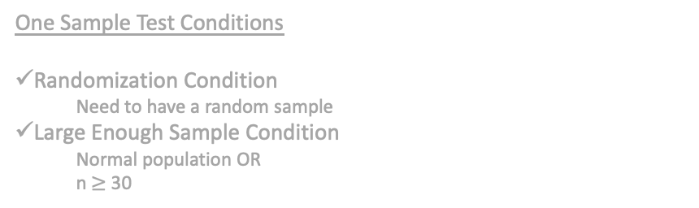
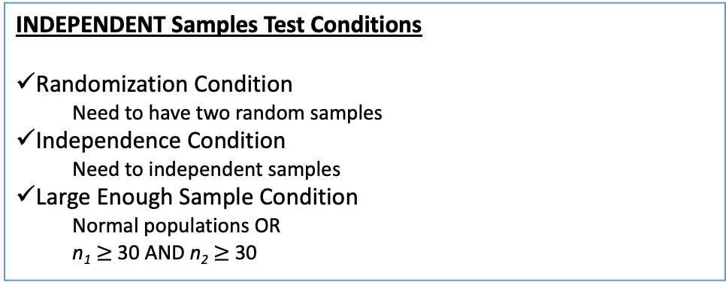
Mean Assumptions - Independent Samples
2. Check Assumptions.
EXACT same Assumptions as for Means Test with one sample, we just have to do it for both!
(Remember we need to know / be given the population standard deviations 𝞂₁ and 𝞂₂ for now)
We have to add one more though!
Must have an assumption about the connection between our two samples
Independence
This is a REALLY important assumption now, because we do a different test based on whether this assumption is met or not!
Right now we are looking at an INDEPENDENT samples test!
We need each group to be independent (unrelated, no connection).
So they results from one group should NOT have any effect / impact on the results of the second group!
One Sample Test Conditions
Randomization Condition
Need to have a random sample
Large Enough Sample Condition
Normal population OR
n $≥$ 30
INDEPENDENT Samples Test Conditions
Randomization Condition
Need to have two random samples
Independence Condition
Need to independent samples
Large Enough Sample Condition
Normal populations OR
n₁ $≥$ 30 AND n₂ $≥$ 30
New conditions

Slide 29
LCQ – Assumptions
Problem: Check the conditions for a Hypothesis Test of the two population proportions for the following scenarios:
a) A researcher randomly sampled 15 infants and 20 toddlers to measure their body temperatures. Let’s assume that body temperatures for all persons are normally distributed with some known standard deviation. Is there sufficient evidence to conclude that the mean body temperatures for infants and toddlers differ?
b) A prospective home buyer is trying to decide which city to move to. In Washington D.C, a random sample of 32 foreclosed homes sold for an average of $443,705 and in Baltimore and random sample of 45 foreclosed homes sold for $450,000. Real estate experts say the standard deviation for sales across the nation is $190,000. Is there sufficient evidence that the Baltimore housing market is more expensive?

Slide 30
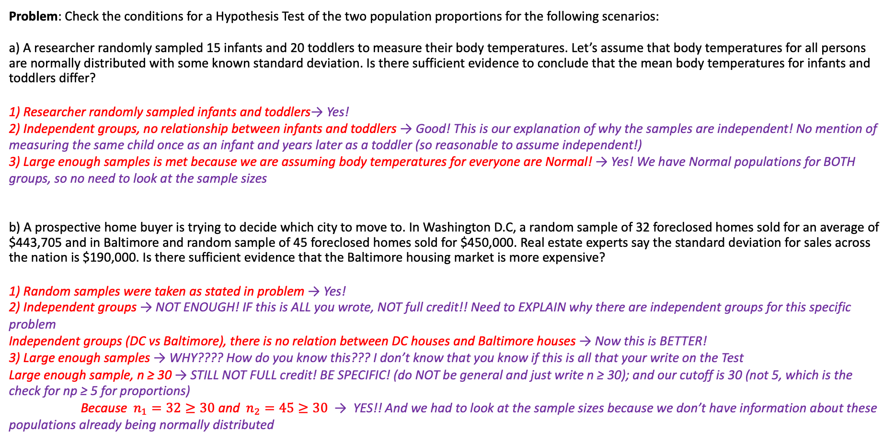
LCQ – Assumptions
Problem: Check the conditions for a Hypothesis Test of the two population proportions for the following scenarios:
a) A researcher randomly sampled 15 infants and 20 toddlers to measure their body temperatures. Let’s assume that body temperatures for all persons are normally distributed with some known standard deviation. Is there sufficient evidence to conclude that the mean body temperatures for infants and toddlers differ?
1) Researcher randomly sampled infants and toddlers→ Yes!
2) Independent groups, no relationship between infants and toddlers → Good! This is our explanation of why the samples are independent! No mention of measuring the same child once as an infant and years later as a toddler (so reasonable to assume independent!)
3) Large enough samples is met because we are assuming body temperatures for everyone are Normal! → Yes! We have Normal populations for BOTH groups, so no need to look at the sample sizes
b) A prospective home buyer is trying to decide which city to move to. In Washington D.C, a random sample of 32 foreclosed homes sold for an average of $443,705 and in Baltimore and random sample of 45 foreclosed homes sold for $450,000. Real estate experts say the standard deviation for sales across the nation is $190,000. Is there sufficient evidence that the Baltimore housing market is more expensive?
1) Random samples were taken as stated in problem → Yes!
2) Independent groups → NOT ENOUGH! IF this is ALL you wrote, NOT full credit!! Need to EXPLAIN why there are independent groups for this specific problem
Independent groups (DC vs Baltimore), there is no relation between DC houses and Baltimore houses → Now this is BETTER!
3) Large enough samples → WHY???? How do you know this??? I don’t know that you know if this is all that your write on the Test
Large enough sample, n ≥ 30 → STILL NOT FULL credit! BE SPECIFIC! (do NOT be general and just write n ≥ 30); and our cutoff is 30 (not 5, which is the check for np ≥ 5 for proportions)
Because $n_{1}=32≥30$ and $n_{2}=45≥30$ → YES!! And we had to look at the sample sizes because we don’t have information about these populations already being normally distributed

Slide 31
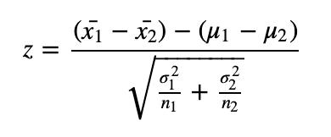
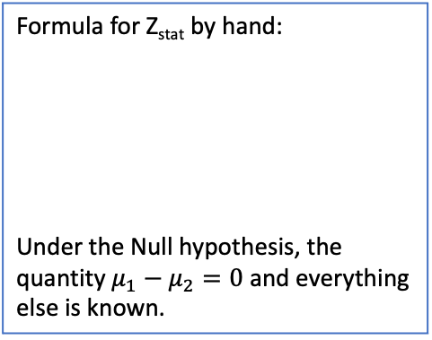
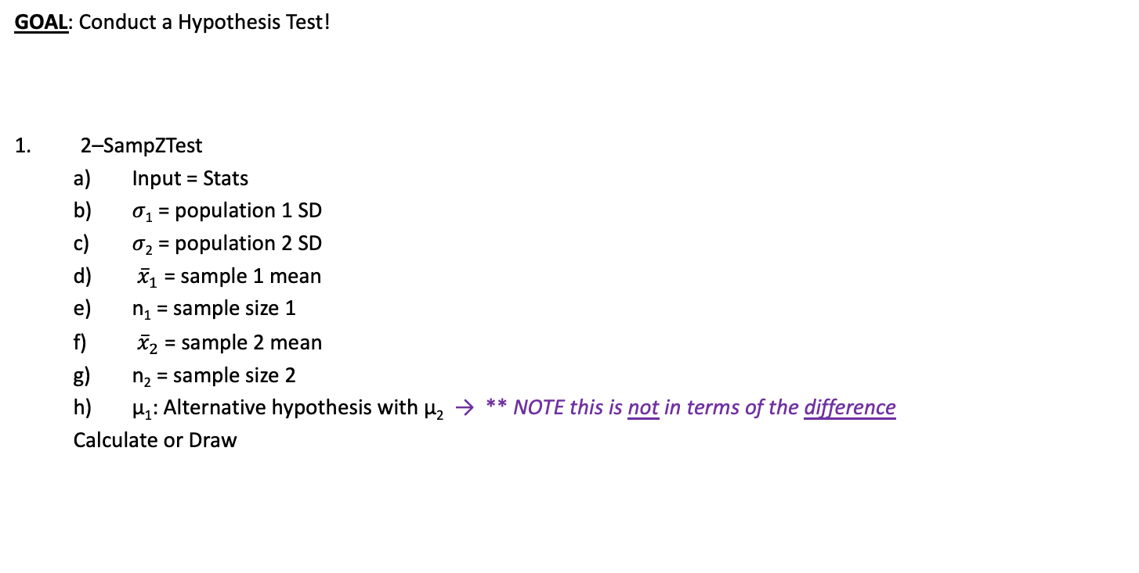
Using Calc - Test Statistic and P-Value for Ind Means and Known 𝞂
4. Compute value of Test Statistic / P-value.
Formula for Z_{stat} by hand:
Under the Null hypothesis, the quantity $μ_{1}−μ_{2}=0$ and everything else is known.
Setup
A prospective home buyer is trying to decide which city to move to. In Washington D.C, a random sample of 32 foreclosed homes sold for an average of $443,705 and in Baltimore and random sample of 45 foreclosed homes sold for $450,000. Real estate experts say the standard deviation for sales across the nation is $190,000. Is there sufficient evidence that the Baltimore housing market is more expensive? Use 𝛼 = 0.1
GOAL: Conduct a Hypothesis Test!
2–SampZTest
Input = Stats
𝜎₁ = population 1 SD
𝜎₂ = population 2 SD
${\overline{x}}_{1}$ = sample 1 mean
n₁ = sample size 1
${\overline{x}}_{2}$ = sample 2 mean
n₂ = sample size 2
µ₁: Alternative hypothesis with µ₂ → ** NOTE this is not in terms of the difference
Calculate or Draw

Slide 32
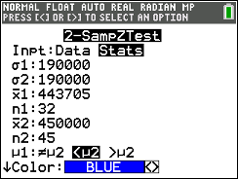
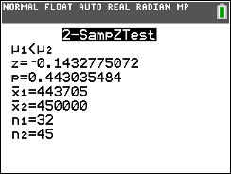
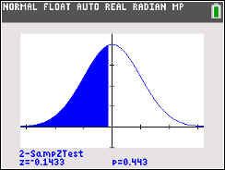
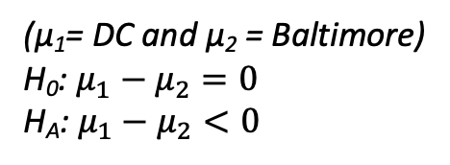
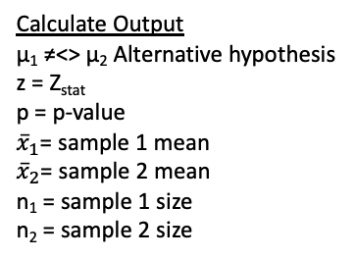
Using Calc - Test Statistic and P-Value for Ind Means and Known 𝞂
4. Compute value of Test Statistic / P-value.
Formula for Z_{stat} by hand:
Under the Null hypothesis, the quantity $μ_{1}−μ_{2}=0$ and everything else is known.
Setup
A prospective home buyer is trying to decide which city to move to. In Washington D.C, a random sample of 32 foreclosed homes sold for an average of $443,705 and in Baltimore and random sample of 45 foreclosed homes sold for $450,000. Real estate experts say the standard deviation for sales across the nation is $190,000. Is there sufficient evidence that the Baltimore housing market is more expensive? Use 𝛼 = 0.1
GOAL: Conduct a Hypothesis Test!
2–SampZTest
Input = Stats
𝜎₁ = population 1 SD
𝜎₂ = population 2 SD
${\overline{x}}_{1}$ = sample 1 mean
n₁ = sample size 1
${\overline{x}}_{2}$ = sample 2 mean
n₂ = sample size 2
µ₁: Alternative hypothesis with µ₂ → ** NOTE this is not in terms of the difference
Calculate or Draw
Calculate Output
µ₁ ≠<> µ₂ Alternative hypothesis
z = Z_{stat}
p = p-value
${\overline{x}}_{1}$= sample 1 mean
${\overline{x}}_{2}$= sample 2 mean
n₁ = sample 1 size
n₂ = sample 2 size
Draw Output
Plot (and displays values) of p = p-value and z = Z_{stat} on the standard normal curve
(µ₁= DC and µ₂ = Baltimore)
H₀: $μ_{1}−μ_{2}=0$
H_{A}: $μ_{1}−μ_{2}<0$

Slide 33
LCQ – Conclusions and Interpretations
5. Conclude and Interpret
State whether you reject H₀ or fail to reject H₀ AND WHY!
Interpret your results in the context of the problem
Problem: Write the conclusions and interpretations for the previous scenarios using our results.
Setup: A prospective home buyer is trying to decide which city to move to. In Washington D.C, a random sample of 32 foreclosed homes sold for an average of $443,705 and in Baltimore and random sample of 45 foreclosed homes sold for $450,000. Real estate experts say the standard deviation for sales across the nation is $190,000. Is there sufficient evidence that the Baltimore housing market is more expensive? Use 𝛼 = 0.1
Solution:

Slide 34
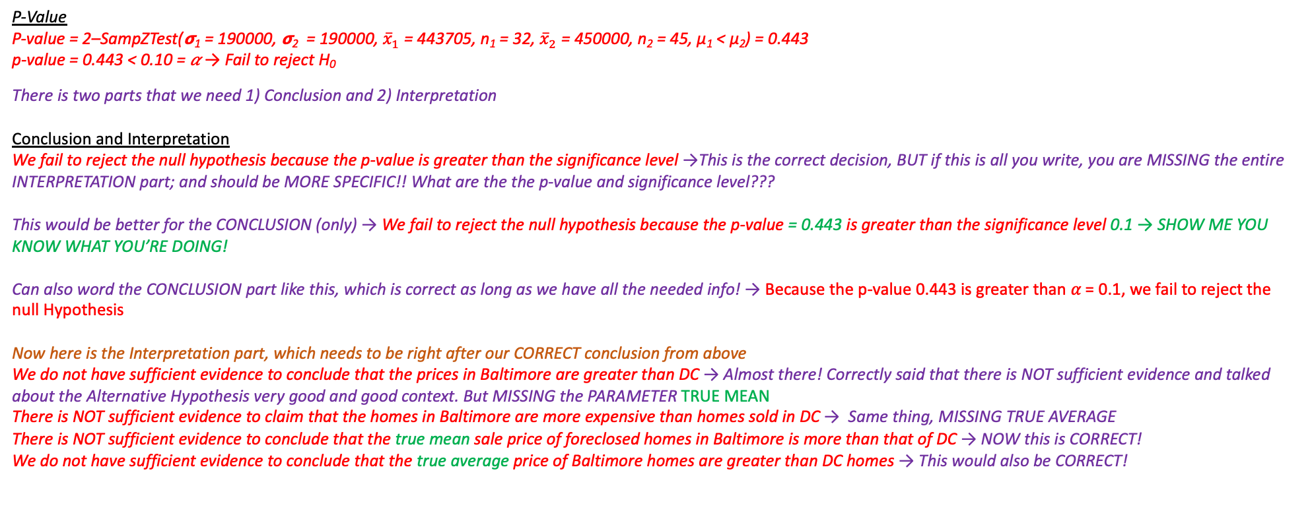
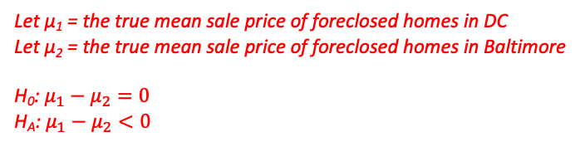
LCQ – Conclusions and Interpretations
5. Conclude and Interpret
State whether you reject H₀ or fail to reject H₀ AND WHY!
Interpret your results in the context of the problem
Problem: Write the conclusions and interpretations for the previous scenarios using our results.
Setup: A prospective home buyer is trying to decide which city to move to. In Washington D.C, a random sample of 32 foreclosed homes sold for an average of $443,705 and in Baltimore and random sample of 45 foreclosed homes sold for $450,000. Real estate experts say the standard deviation for sales across the nation is $190,000. Is there sufficient evidence that the Baltimore housing market is more expensive? Use 𝛼 = 0.1
Solution:
Need these…
Let µ₁ = the true mean sale price of foreclosed homes in DC
Let µ₂ = the true mean sale price of foreclosed homes in Baltimore
H₀: $μ_{1}−μ_{2}=0$
H_{A}: $μ_{1}−μ_{2}<0$
𝛼 = 0.1
P-Value
P-value = 2–SampZTest(𝞂₁ = 190000, 𝞂₂ = 190000, ${\overline{x}}_{1}$ = 443705, n₁ = 32, ${\overline{x}}_{2}$ = 450000, n₂ = 45, µ₁ < µ₂) = 0.443
p-value = 0.443 < 0.10 = 𝛼 → Fail to reject H₀
There is two parts that we need 1) Conclusion and 2) Interpretation
Conclusion and Interpretation
We fail to reject the null hypothesis because the p-value is greater than the significance level →This is the correct decision, BUT if this is all you write, you are MISSING the entire INTERPRETATION part; and should be MORE SPECIFIC!! What are the the p-value and significance level???
This would be better for the CONCLUSION (only) → We fail to reject the null hypothesis because the p-value = 0.443 is greater than the significance level 0.1 → SHOW ME YOU KNOW WHAT YOU’RE DOING!
Can also word the CONCLUSION part like this, which is correct as long as we have all the needed info! → Because the p-value 0.443 is greater than 𝛼 = 0.1, we fail to reject the null Hypothesis
Now here is the Interpretation part, which needs to be right after our CORRECT conclusion from above
We do not have sufficient evidence to conclude that the prices in Baltimore are greater than DC → Almost there! Correctly said that there is NOT sufficient evidence and talked about the Alternative Hypothesis very good and good context. But MISSING the PARAMETER TRUE MEAN
There is NOT sufficient evidence to claim that the homes in Baltimore are more expensive than homes sold in DC → Same thing, MISSING TRUE AVERAGE
There is NOT sufficient evidence to conclude that the true mean sale price of foreclosed homes in Baltimore is more than that of DC → NOW this is CORRECT!
We do not have sufficient evidence to conclude that the true average price of Baltimore homes are greater than DC homes → This would also be CORRECT!

Slide 35
Hypothesis Tests for Means – INDEPENDENT Samples (and Unknown 𝞂)
Now we will go over UNKNOWN population standard deviations!
This is the scenario when ONLY SAMPLE standard deviations are given
All of the previous Two Sample overview applies and the Means Hypotheses, Conditions and Interpretations are the same
Our test is just based on the T distribution now!
This is still for independent samples!

Slide 36
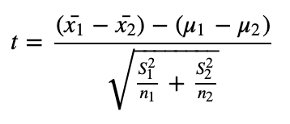
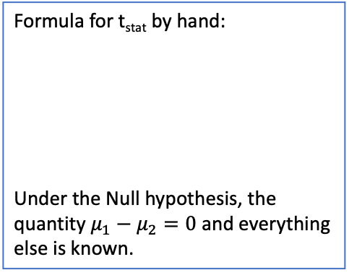
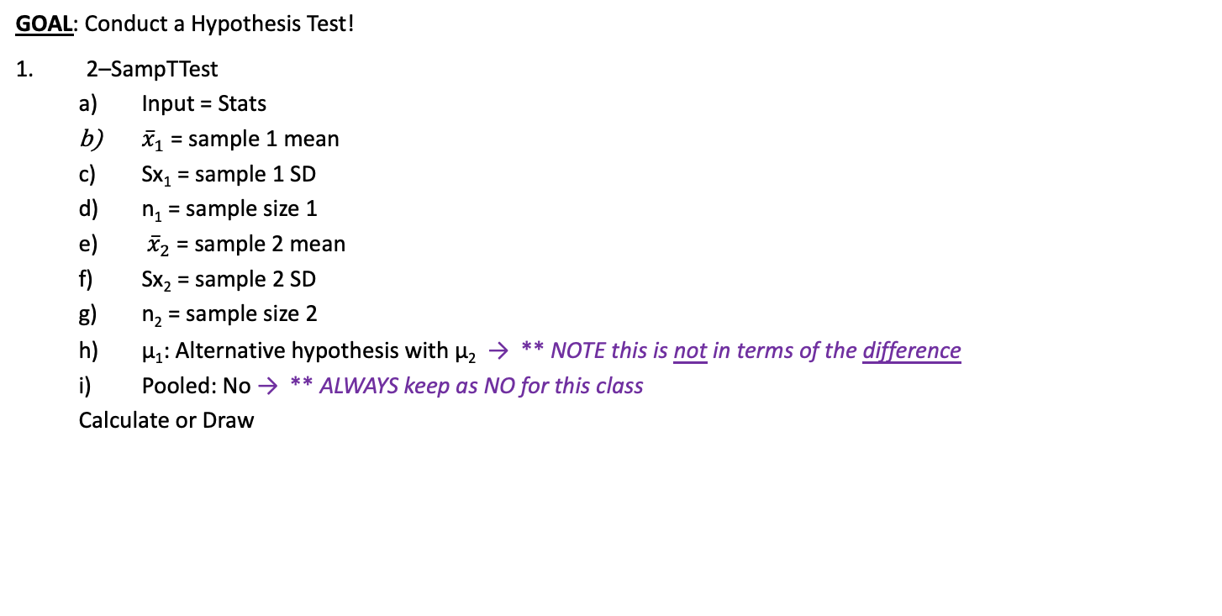
Using Calc - Test Statistic and P-Value for Ind Means and Unknown 𝞂
4. Compute value of Test Statistic / P-value.
Formula for t_{stat} by hand:
Under the Null hypothesis, the quantity $μ_{1}−μ_{2}=0$ and everything else is known.
Setup
A prospective home buyer is trying to decide which city to move to. In Washington D.C, a random sample of 32 foreclosed homes sold for an average of $443,705 with standard deviation $150,000 and in Baltimore and random sample of 45 foreclosed homes sold for $450,000 with standard deviation $130,000. Is there sufficient evidence that the Baltimore housing market is more expensive? Use 𝛼 = 0.1
GOAL: Conduct a Hypothesis Test!
2–SampTTest
Input = Stats
${\overline{x}}_{1}$ = sample 1 mean
Sx₁ = sample 1 SD
n₁ = sample size 1
${\overline{x}}_{2}$ = sample 2 mean
Sx₂ = sample 2 SD
n₂ = sample size 2
µ₁: Alternative hypothesis with µ₂ → ** NOTE this is not in terms of the difference
Pooled: No → ** ALWAYS keep as NO for this class
Calculate or Draw
*** Degrees of Freedom
There is a difficult fancy way to determine the DF for two sample T-Tests (which our calc does) that we aren’t going to do
So only going to be making conclusions using the p-value method
*** Pooled Standard Deviation
We have the option to use a weighted average of the two sample standard deviations
This is appropriate if the two values are similar and results in a slightly better test
But we are going to keep it simple and ALWAYS NOT pool the SDs

Slide 37
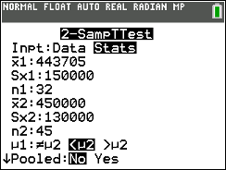
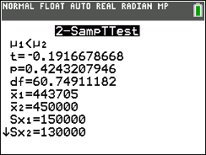
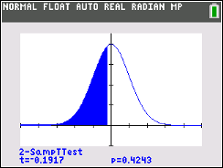
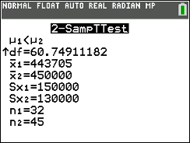
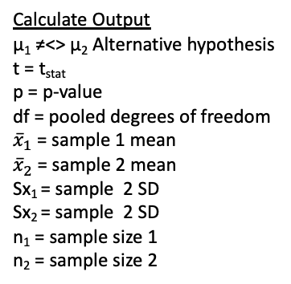
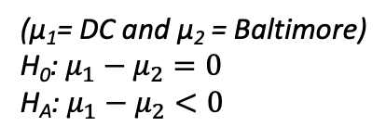
Using Calc - Test Statistic and P-Value for Ind Means and Unknown 𝞂
4. Compute value of Test Statistic / P-value.
Formula for t_{stat} by hand:
Under the Null hypothesis, the quantity $μ_{1}−μ_{2}=0$ and everything else is known.
Setup
A prospective home buyer is trying to decide which city to move to. In Washington D.C, a random sample of 32 foreclosed homes sold for an average of $443,705 with standard deviation $150,000 and in Baltimore and random sample of 45 foreclosed homes sold for $450,000 with standard deviation $130,000. Is there sufficient evidence that the Baltimore housing market is more expensive? Use 𝛼 = 0.1
GOAL: Conduct a Hypothesis Test!
2–SampTTest
Input = Stats
${\overline{x}}_{1}$ = sample 1 mean
Sx₁ = sample 1 SD
n₁ = sample size 1
${\overline{x}}_{2}$ = sample 2 mean
Sx₂ = sample 2 SD
n₂ = sample size 2
µ₁: Alternative hypothesis with µ₂ → ** NOTE this is not in terms of the difference
Pooled: No → ** ALWAYS keep as NO for this class
Calculate or Draw
Calculate Output
µ₁ ≠<> µ₂ Alternative hypothesis
t = t_{stat}
p = p-value
df = pooled degrees of freedom
${\overline{x}}_{1}$ = sample 1 mean
${\overline{x}}_{2}$ = sample 2 mean
Sx₁ = sample 2 SD
Sx₂ = sample 2 SD
n₁ = sample size 1
n₂ = sample size 2
Draw Output
Plot (and displays values) of p = p-value and t = t_{stat} on the standard normal curve
(µ₁= DC and µ₂ = Baltimore)
H₀: $μ_{1}−μ_{2}=0$
H_{A}: $μ_{1}−μ_{2}<0$
*** Degrees of Freedom
There is a difficult fancy way to determine the DF for two sample T-Tests (which our calc does) that we aren’t going to do
So only going to be making conclusions using the p-value method
*** Pooled Standard Deviation
We have the option to use a weighted average of the two sample standard deviations
This is appropriate if the two values are similar and results in a slightly better test
But we are going to keep it simple and ALWAYS NOT pool the SDs

Slide 38
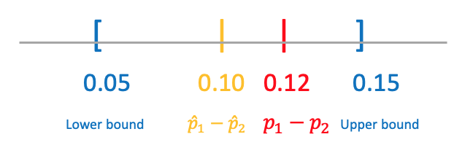
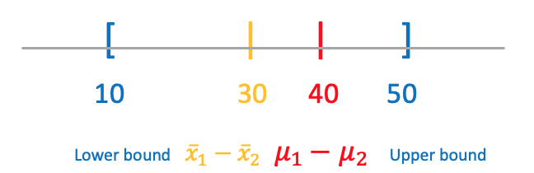
Confidence Intervals – Two Samples!
Everything we learned about Confidence Intervals (the different pieces, interpretation, etc.) still applies!
Now we are just trying to estimate the DIFFERENCE between the two parameters!

Slide 39
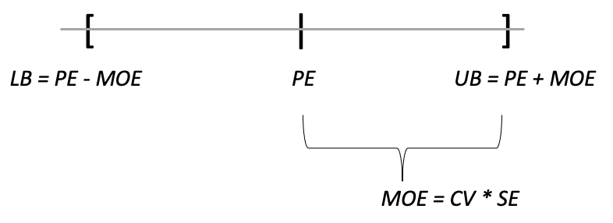
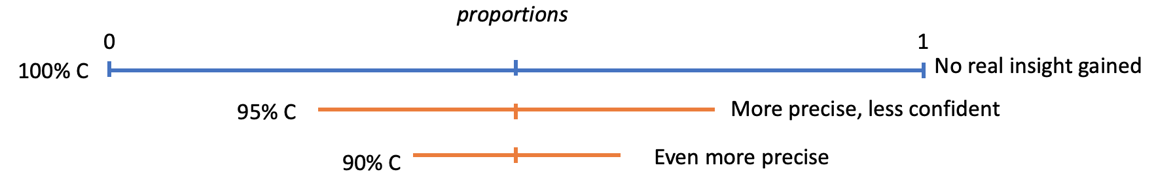
Structure of a Two Sample Confidence Interval
SAME structure as the One Sample Confidence Intervals we learned previously
C.I. = Point Estimate ± Margin of Error
But Now with Two Samples
Point Estimate is your best guess of the DIFFERENCE; at the center of the interval.
Margin of Error (MOE) = Critical Value (CV) * Standard Error (SE).
CV are the exact same!
SE formulas are slightly different because we have an additional sample
Same relationships with MOE: Smaller MOE, more precise your estimate of the difference is.
The more confident, the wider your interval is (if everything else stays the same)
Tradeoff between Precision and Confidence

Slide 40
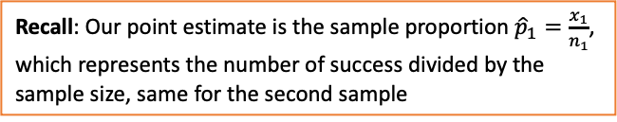
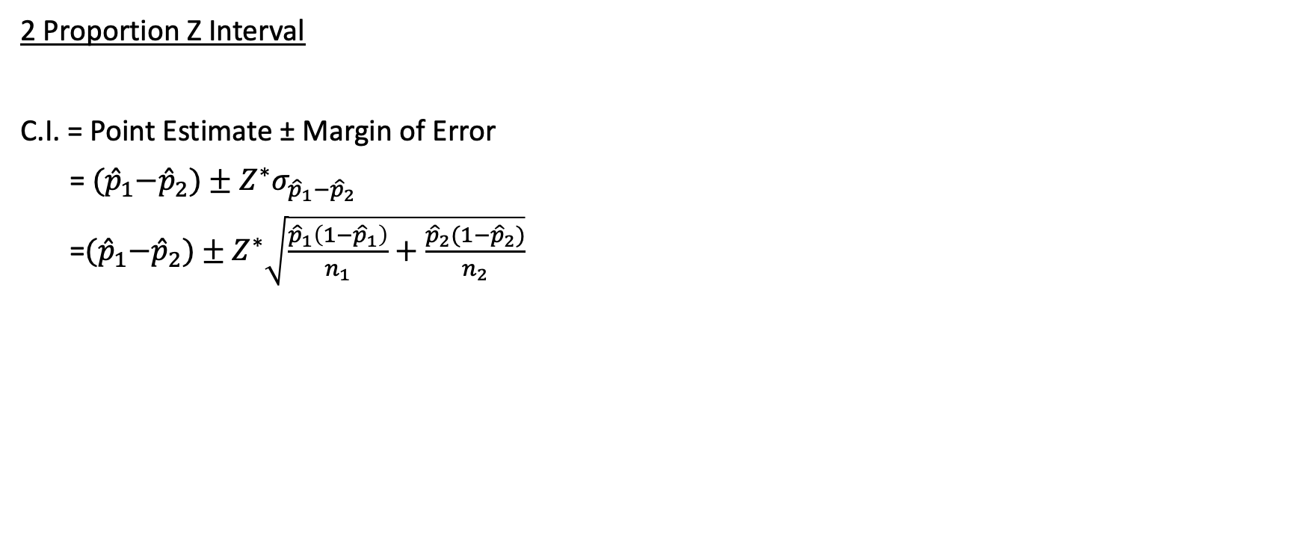
Final Confidence Interval for p₁ – p₂
Recall: Our point estimate is the sample proportion ${\hat{p}}_{1}=\frac{x_{1}}{n_{1}}$, which represents the number of success divided by the sample size, same for the second sample
2 Proportion Z Interval
C.I. = Point Estimate ± Margin of Error
= ${(\hat{p}}_{1}−{\hat{p}}_{2})±Z^{∗}σ_{{\hat{p}}_{1}−{\hat{p}}_{2}}$
=${(\hat{p}}_{1}−{\hat{p}}_{2})±Z^{∗}\sqrt{\frac{{\hat{p}}_{1}\left(1−{\hat{p}}_{1}\right)}{n_{1}}+\frac{{\hat{p}}_{2}(1−{\hat{p}}_{2})}{n_{2}}}$
TWO Sample Interval Conditions
Randomization Condition
Need to have two random samples
Independence Condition
Need to independent samples
Large Enough Sample Condition
AT LEAST 5 successes and 5 failures in EACH collected sample
Using Calc
GOAL: Find the Two Sample Confidence Interval for Difference in Proportions!
2-PropZInt
x₁ = # of successes (people that said yes) in sample 1
n₁ = sample size
x₂ = # of successes in sample 2
n₂ = sample size 2
C-Level = Confidence level (as a decimal or whole number, both work)
Setup
A NatGeo Poll interviewed 1200 hiking enthusiasts and 1100 climbers. They asked “Are you more afraid of spiders or snakes???” 768 of the 1200 hikers and 662 of the 1100 climbers, responded “Ewww, snakes….” Calculate a 95% Confidence Interval for the difference in proportions.
** Have to state which parameter is 1 and which is 2

Slide 41
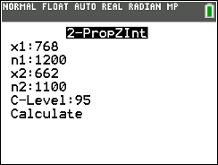

Final Confidence Interval for p₁ – p₂
Recall: Our point estimate is the sample proportion ${\hat{p}}_{1}=\frac{x_{1}}{n_{1}}$, which represents the number of success divided by the sample size, same for the second sample
2 Proportion Z Interval
C.I. = Point Estimate ± Margin of Error
= ${(\hat{p}}_{1}−{\hat{p}}_{2})±Z^{∗}σ_{{\hat{p}}_{1}−{\hat{p}}_{2}}$
=${(\hat{p}}_{1}−{\hat{p}}_{2})±Z^{∗}\sqrt{\frac{{\hat{p}}_{1}\left(1−{\hat{p}}_{1}\right)}{n_{1}}+\frac{{\hat{p}}_{2}(1−{\hat{p}}_{2})}{n_{2}}}$
TWO Sample Interval Conditions
Randomization Condition
Need to have two random samples
Independence Condition
Need to independent samples
Large Enough Sample Condition
AT LEAST 5 successes and 5 failures in EACH collected sample
Using Calc
GOAL: Find the Two Sample Confidence Interval for Difference in Proportions!
2-PropZInt
x₁ = # of successes (people that said yes) in sample 1
n₁ = sample size
x₂ = # of successes in sample 2
n₂ = sample size 2
C-Level = Confidence level (as a decimal or whole number, both work)
Setup
A NatGeo Poll interviewed 1200 hiking enthusiasts and 1100 climbers. They asked “Are you more afraid of spiders or snakes???” 768 of the 1200 hikers and 662 of the 1100 climbers, responded “Ewww, snakes….” Calculate a 95% Confidence Interval for the difference in proportions.
** Have to state which parameter is 1 and which is 2
p₁ → hikers
p₂ → climbers

Slide 42



Final Confidence Interval for µ₁ – µ₂ INDEPENDENT Samples
2 Sample Z Interval – KNOWN 𝞂s
C.I. = Point Estimate ± Margin of Error
= ${(\overline{x}}_{1}−{\overline{x}}_{2})±Z^{∗}σ_{{\overline{x}}_{1}−{\overline{x}}_{2}}$
= ${(\overline{x}}_{1}−{\overline{x}}_{2})±Z^{∗}\sqrt{\frac{σ_{1}}{n_{1}}+\frac{σ_{2}}{n_{2}}}$
* Same Critical Value as with a 2 Proportion Z Interval
INDEPENDENT Samples Interval Conditions
Randomization Condition
Need to have two random samples
Independence Condition
Need to independent samples
Large Enough Sample Condition
Normal populations OR
n₁ $≥$ 30 AND n₂ $≥$ 30
Using Calc
GOAL: Find the Two Sample Confidence Interval for Difference in Means!!
2-SampZInt
Input = Stats
𝞂₁ = population 1 standard deviation
𝞂₂ = population 1 standard deviation
$\overline{x}1$ = sample mean 1
n₁ = sample size
$\overline{x}2$ = sample mean 2
n₂ = sample size
C-Level = Confidence level (as a decimal or whole number, both work)
Setup
A prospective home buyer is trying to decide which city to move to. In Washington D.C, a random sample of 32 foreclosed homes sold for an average of $443,705 and in Baltimore and random sample of 45 foreclosed homes sold for $450,000. Real estate experts say the standard deviation for sales across the nation is $190,000. Calculate a 85% Confidence Interval for the difference in means.
** Have to state which parameter is 1 and which is 2

Slide 43



Final Confidence Interval for µ₁ – µ₂ INDEPENDENT Samples
2 Sample Z Interval – KNOWN 𝞂s
C.I. = Point Estimate ± Margin of Error
= ${(\overline{x}}_{1}−{\overline{x}}_{2})±Z^{∗}σ_{{\overline{x}}_{1}−{\overline{x}}_{2}}$
= ${(\overline{x}}_{1}−{\overline{x}}_{2})±Z^{∗}\sqrt{\frac{σ_{1}}{n_{1}}+\frac{σ_{2}}{n_{2}}}$
* Same Critical Value as with a 2 Proportion Z Interval
INDEPENDENT Samples Interval Conditions
Randomization Condition
Need to have two random samples
Independence Condition
Need to independent samples
Large Enough Sample Condition
Normal populations OR
n₁ $≥$ 30 AND n₂ $≥$ 30
Using Calc
GOAL: Find the Two Sample Confidence Interval for Difference in Means!!
2-SampZInt
Input = Stats
𝞂₁ = population 1 standard deviation
𝞂₂ = population 1 standard deviation
$\overline{x}1$ = sample mean 1
n₁ = sample size
$\overline{x}2$ = sample mean 2
n₂ = sample size
C-Level = Confidence level (as a decimal or whole number, both work)
Setup
A prospective home buyer is trying to decide which city to move to. In Washington D.C, a random sample of 32 foreclosed homes sold for an average of $443,705 and in Baltimore and random sample of 45 foreclosed homes sold for $450,000. Real estate experts say the standard deviation for sales across the nation is $190,000. Calculate a 85% Confidence Interval for the difference in means.
** Have to state which parameter is 1 and which is 2
µ₁ → DC
µ₂ → Baltimore

Slide 44



Final Confidence Interval for µ₁ – µ₂ INDEPENDENT Samples
*** Degrees of Freedom
There is a difficult fancy way to determine the DF for two sample, (which our calc does) that we wouldn’t do by hand
2 Sample t Interval – UNKNOWN 𝞂s
C.I. = Point Estimate ± Margin of Error
= ${(\overline{x}}_{1}−{\overline{x}}_{2})±t^{∗} σ_{{\overline{x}}_{1}−{\overline{x}}_{2}}$
=${(\overline{x}}_{1}−{\overline{x}}_{2})±t^{∗}\sqrt{\frac{s_{1}}{n_{1}}+\frac{s_{2}}{n_{2}}}$
* Same Critical Value is based on t distribution now
INDEPENDENT Samples Interval Conditions
Randomization Condition
Need to have two random samples
Independence Condition
Need to independent samples
Large Enough Sample Condition
Normal populations OR
n₁ $≥$ 30 AND n₂ $≥$ 30
Using Calc
GOAL: Find the Two Sample Confidence Interval for Difference in Means!!
2-SameTInt
Input = Stats
$\overline{x}1$ = sample mean 1
Sx₁ = population 1 standard deviation
n₁ = sample size 1
$\overline{x}2$ = sample mean 2
Sx₂ = population 2 standard deviation
n₂ = sample size 2
Pooled = No
C-Level = Confidence level (as a decimal or whole number, both work)
Setup
A prospective home buyer is trying to decide which city to move to. In Washington D.C, a random sample of 32 foreclosed homes sold for an average of $443,705 with standard deviation $150,000 and in Baltimore and random sample of 45 foreclosed homes sold for $450,000 with standard deviation $130,000. Calculate a 85% Confidence Interval for the difference in means.
** Have to state which parameter is 1 and which is 2
*** Pooled Standard Deviation
We have the option to use a weighted average of the two sample standard deviations
This is appropriate if the two values are similar and results in a slightly more precise interval
But we are going to keep it simple and ALWAYS NOT pool the SDs

Slide 45


Final Confidence Interval for µ₁ – µ₂ INDEPENDENT Samples
*** Degrees of Freedom
There is a difficult fancy way to determine the DF for two sample, (which our calc does) that we wouldn’t do by hand
2 Sample t Interval – UNKNOWN 𝞂s
C.I. = Point Estimate ± Margin of Error
= ${(\overline{x}}_{1}−{\overline{x}}_{2})±t^{∗} σ_{{\overline{x}}_{1}−{\overline{x}}_{2}}$
=${(\overline{x}}_{1}−{\overline{x}}_{2})±t^{∗}\sqrt{\frac{s_{1}}{n_{1}}+\frac{s_{2}}{n_{2}}}$
* Same Critical Value is based on t distribution now
INDEPENDENT Samples Interval Conditions
Randomization Condition
Need to have two random samples
Independence Condition
Need to independent samples
Large Enough Sample Condition
Normal populations OR
n₁ $≥$ 30 AND n₂ $≥$ 30
Using Calc
GOAL: Find the Two Sample Confidence Interval for Difference in Means!!
2-SameTInt
Input = Stats
$\overline{x}1$ = sample mean 1
Sx₁ = population 1 standard deviation
n₁ = sample size 1
$\overline{x}2$ = sample mean 2
Sx₂ = population 2 standard deviation
n₂ = sample size 2
Pooled = No
C-Level = Confidence level (as a decimal or whole number, both work)
Setup
A prospective home buyer is trying to decide which city to move to. In Washington D.C, a random sample of 32 foreclosed homes sold for an average of $443,705 with standard deviation $150,000 and in Baltimore and random sample of 45 foreclosed homes sold for $450,000 with standard deviation $130,000. Calculate a 85% Confidence Interval for the difference in means.
** Have to state which parameter is 1 and which is 2
µ₁ → DC
µ₂ → Baltimore
*** Pooled Standard Deviation
We have the option to use a weighted average of the two sample standard deviations
This is appropriate if the two values are similar and results in a slightly more precise interval
But we are going to keep it simple and ALWAYS NOT pool the SDs

Slide 46
Hypothesis Tests and Confidence Intervals
What each type of inference tells us
For One Sample
Hypothesis tests tell us how a parameter compares to a specific value (greater than, less than, or not equal to)
Confidence intervals give us a range of plausible values
For Two Sample
Hypothesis Tests tell us if there is a difference between the two parameters
Confidence Intervals give us a range of plausible values for this difference
Both of these inference methods can be used together!
Example
A hypothesis test on a random sample of 200 American adults found that greater than 50% of them have tried marijuana
This conclusion just tells us that the true proportion is somewhere above 50%
A confidence interval could be constructed to find how much more than 50% of American adults have tried marijuana
Lets say CI = (0.52, 0.60), then we have a specific estimate as to where the true proportion actually is, from 52% to 60%. This tells us exactly where we think the parameter is and how much greater than 50% it is! MORE INFORMATION
CI for Testing
Confidence Intervals actually give us enough information to say whether or not we would reject a corresponding Hypothesis Test!

Slide 47

LCQ – Confidence Intervals for Testing
Problem: Based on the parameters below, make a conclusion whether we would reject or fail to reject the Hypothesis Test below based on each of the following Confidence Intervals.
Let μ₁ = population mean height of football teams in meters
Let μ₂ = population mean height of soccer teams in meters
$H_{0}: µ_{1}− µ_{2}=0$
$H_{A}: µ_{1}− µ_{2}≠0$
a) 85% CI for μ₁ - μ₂ → (-0.3, -0.05)
b) 90% CI for μ₁ - μ₂ → (-0.1, 0.2)
c) 90% CI for μ₁ - μ₂ → (0.03, 0.36)

Slide 48




LCQ – Confidence Intervals for Testing
Problem: Based on the parameters below, make a conclusion whether we would reject or fail to reject the Hypothesis Test below based on each of the following Confidence Intervals and explain why.
Let μ₁ = population mean height of football teams in meters
Let μ₂ = population mean height of soccer teams in meters
$H_{0}: µ_{1}− µ_{2}=0$
$H_{A}: µ_{1}− µ_{2}≠0$
a) 85% CI for μ₁ - μ₂ → (-0.3, -0.05)
REJECT→ because the entire interval is below zero! Here’s the long description of why we would reject:
A confidence interval gives a range of plausible values for the parameter we are estimating, in this case it is the difference between µ₁ and µ₂
Under the Null, we are assuming this difference is zero (so they are equivalent)
Well our entire CI is below this null difference of zero, which means it is NOT a plausible value based on our results!
So this would be enough evidence to show that these two parameters are different
And also we know that the entire interval is negative. So based on the order of subtraction in the hypotheses, this indicates that µ₂ is LARGER! Average heights of soccer teams are larger based on this interval.
This conclusion would MATCH the conclusion if we actually did the Hypothesis Test for this. And we would get a negative Test Statistic, also indicating that µ₂ is bigger
b) 90% CI for μ₁ - μ₂ → (-0.1, 0.2)
FAIL TO REJECT → because the entire interval is above zero!
Now our interval starts negative, crosses zero and end positive (so zero is contained in the interval)
This says that zero is a plausible value for the difference of these two parameters, which means it’s possible that they are equivalent!
We can NOT say that one is ALWAYS larger than the other, so we would NOT be able to conclude they are significantly different → so would fail to reject the Null
c) 95% CI for μ₁ - μ₂ → (0.03, 0.36)
REJECT→ because the entire interval is above zero!
Our interval suggest that zero is not a possible value for the difference of these two parameters, so it’s not possible that they are equivalent based on our results
That is exactly what rejecting the null hypothesis tells us!
And because the interval is positive, this time µ₂ is LARGER (subtracting a smaller number from a larger number results in a positive difference) so the average heights of football teams are greater than soccer teams

Slide 49
Two Sample Confidence Interval Interpretations
General Structure
Here was the structure for ONE sample CI:
I am % confident that the true/population parameter + context is between (lower bound) and (upper bound).
It is not as structured when discussing TWO parameters, but we still have the same key parts below
3 Pieces
95% Confident: This is a Confidence Statement
Tells us what percent off ALL possible samples result in a CI that captures the true proportion.
Parameters + Context: We are talking about TWO parameters.
But what parameters??? We ALWAYS need context.
Now because we have TWO parameters, we can be specific about which one is greater / less than!
Interval: The range of plausible values for the DIFFERENCE!
Uses the difference of our sample statistics and the MOE based on Two Sample Standard Errors.
Example
Let p₁ = true proportion of Columbus males who enjoy running
Let p₂ = true proportion of Columbus females who enjoy running
95% CI for p₁ - p₂ = (0.05, 0.25)
We are 95% confident that the true proportion of all Columbus males who enjoy running is between 0.05 and 0.25 greater than the true proportion of females who enjoy running.
Or equivalently but slightly shorter → We are 95% confident that the true proportion of all Columbus males who enjoy running is between 0.05 and 0.25 greater than that of females.
** Wording gets a little tricky when the CI of the difference contains zero (negative lower bound and positive upper bound)… but nonetheless same logic

Slide 50
LCQ – Two Sample CI Interpretations
Problem: Based on the parameters below, interpret each of the following Confidence Intervals.
Let μ₁ = population mean height of football teams (meters)
Let μ₂ = population mean height of soccer teams (meters)
a) 85% CI for μ₁ - μ₂ → (-0.3, -0.05)
b) 90% CI for μ₁ - μ₂ → (-0.1, 0.2)
c) 95% CI for μ₁ - μ₂ > 0→ (0.03, 0.36)

Slide 51
LCQ – Two Sample CI Interpretations
Problem: Based on the parameters below, interpret each of the following Confidence Intervals.
Let μ₁ = population mean height of football teams (meters)
Let μ₂ = population mean height of soccer teams (meters)
a) 85% CI for μ₁ - μ₂ → (-0.3, -0.05) → We already talked how this interval indicates μ₁ < μ₂. So we can phrase our CI interpretation using this knowledge:
We are 85% confident that the population mean height of football teams is between 0.05 and 0.3 meters less than the population mean height of soccer teams
Or equivalently (rearranging with μ₂ > μ₁): We are 85% confident that the population mean height of soccer teams is between 0.05 and 0.3 meters greater than the population mean height of football teams
b) 90% CI for μ₁ - μ₂ → (-0.1, 0.2) → Here we can’t say definitively that one mean is greater, so our wording needs to reflect that μ₁ can be less than OR greater than μ₂ (this wording is a little less straightforward than before)
We are 90% the that true mean height of football teams is between 0.1 meters less than OR 0.2 meters greater than the true mean height of soccer teams
Or equivalently (rearranging with μ₂ - μ₁): We are 90% confident that the population mean height of soccer teams is between 0.2 meters less than OR 0.1 meters greater than the population mean height of football teams
c) 95% CI for μ₁ - μ₂ > 0→ (0.03, 0.36) → We know this interval indicates μ₁ > μ₂. So we can again phrase our CI interpretation in that way:
We are 95% confident that the true mean height of football teams is between 0.03 and 0.36 meters taller than the true mean height of soccer teams
Or equivalently (rearranging with μ₂ < μ₁): We are 95% confident that the population mean height of soccer players is between 0.03 and 0.36 meters shorter than the population mean height of football players

Slide 52
LCQ 2 – Two Sample CI Interpretations
Problem: Based on the parameters below, interpret each of the following Confidence Intervals. Then determine if you would reject or fail to the corresponding Hypothesis Test.
Let μ₁ = population mean price ($) at an Italian restaurant
Let μ₂ = population mean price ($) at a Mexican restaurant
H₀: µ₁ - µ₂ = 0
H_{A}: µ₁ - µ₂ ≠ 0
a) 85% CI for μ₁ - μ₂ → (-30, -3)
b) 90% CI for μ₁ - μ₂ → (-5, 20)
c) 95% CI for μ₁ - μ₂ > 0→ (3, 10)

Slide 53
LCQ 2 – Two Sample CI Interpretations
Problem: Based on the parameters below, interpret each of the following Confidence Intervals. Then determine if you would reject or fail to the corresponding Hypothesis Test.
Let μ₁ = population mean price ($) at an Italian restaurant
Let μ₂ = population mean price ($) at a Mexican restaurant
H₀: µ₁ - µ₂ = 0
H_{A}: µ₁ - µ₂ ≠ 0
a) 85% CI for μ₁ - μ₂ → (-30, -3) Reject test! Difference of zero ↔ equal is NOT plausible based on interval (not captured)
Options
I am 85% confident that the true mean price at the Italian restaurant is less than that of the true mean price at the Mexican restaurant → Correct but MISSING the values of the CI! The whole goal of a CI is to find the range of plausible values, so use them in the interpretation!!
I am 85% confident that the true mean price at the Italian restaurant is less (-30, -3) than that of the true mean price at the Mexican restaurant → Correct, but the phrasing for the values should be IMPROVED!! This is NOT how we would try to talk to someone when comparing the prices of two restaurants! Make it flow, how we would naturally speak it
We are 85% confident that the true mean price of dinner at an Italian restaurant is between $3 and $30 less expensive than the true mean price of dinner at a Mexican restaurant → PERFECT!!!, saying ‘less than’ takes care of the negatives and now it reads much better!
We are 85% confident that the true mean Mexican food price is $3 to $30 less expensive than the true mean of Italian food price → WRONG!! We have a negative interval for the subtraction, so the second parameter must be larger LARGER (order matters in our interpretation). We could flip it to say it like option 5
We are 85% confident that the true mean Mexican food price is $3 to $30 MORE expensive than the true mean of Italian food price → Now this is CORRECT!! Italian less expensive is equivalent to Mexican more expensive!

Slide 54
LCQ 2 – Two Sample CI Interpretations
Problem: Based on the parameters below, interpret each of the following Confidence Intervals. Then determine if you would reject or fail to the corresponding Hypothesis Test.
Let μ₁ = population mean price ($) at an Italian restaurant
Let μ₂ = population mean price ($) at a Mexican restaurant
H₀: µ₁ - µ₂ = 0
H_{A}: µ₁ - µ₂ ≠ 0
b) 90% CI for μ₁ - μ₂ → (-5, 20) Fail to Reject test! Difference of zero ↔ equal IS plausible based on interval (contained within)
Process
This wording is more tricky than before because we have a negative lower bound and positive upper bound, not strictly less expensive or strictly more expensive.
But we can word our interpretation one bound at a time like so and put the pieces together:
Start with µ₁ = Italian → We are 90% confident that the true mean price of an Italian restaurant is between
Now talk about the negative lower bound -5 → (Italian) $5 less expensive (than Mexican)
Now positive upper bound 20 → $20 more expensive (than Mexican)
End with µ₂ = Mexican → than the true mean price of a Mexican restaurant
All together 1+ 2 + 3 + 4 → We are 90% confident that the true mean price of an Italian restaurant is between $5 less expensive and $20 more expensive than the true mean price at a Mexican restaurant
c) 95% CI for μ₁ - μ₂ > 0→ (3, 10) Reject test! Difference of zero ↔ equal is NOT plausible based on interval (NOT contained inside)
Process
We can even do an entirely positive interval like this as well, one bound at a time like so and put the pieces together:
Start with µ₁ = Italian → We are 95% confident that the true mean price of an Italian restaurant is between
Now talk about the negative lower bound 3 → (Italian) $3 more expensive (than Mexican)
Now positive upper bound 10 → $10 more expensive (than Mexican)
End with µ₂ = Mexican → than the true mean price of a Mexican restaurant
All together 1+ 2 + 3 + 4 → We are 95% confident that the true mean price of an Italian restaurant is between $3 more expensive and $10 more expensive than the true mean price at a Mexican restaurant
Can simplify wording a bit cause both are more expensive → We are 95% confident that the true mean price of an Italian restaurant is between $3 and $10 more expensive than the true mean price at a Mexican restaurant

Slide 55






LCQ 2 – Two Sample CI Interpretations
Problem: Based on the parameters below, interpret each of the following Confidence Intervals.
Let μ₁ = population mean price ($) at an Italian restaurant
Let μ₂ = population mean price ($) at a Mexican restaurant
H0: µ1 - µ2 = 0
HA: µ1 - µ2 ≠ 0
a) 85% CI for μ₁ - μ₂ → (-30, -3)
I am 85% confident that the true mean price at the Italian restaurant is less than that of the true mean price at the Mexican restaurant
We are 85% confident that the true mean price of dinner at an Italian restaurant is between $3 and $30 less expensive than the true mean price of dinner at a Mexican restaurant
We are 85% confident that the true mean Mexican food price is $3 to $30 MORE expensive than the true mean of Italian food price
b) 90% CI for μ₁ - μ₂ → (-5, 20)
We are 90% confident that the true mean price of Italian restaurant is between $5 less expensive and $20 more expensive than the true mean price of Mexican
We are 90% confident that the true mean price of a dinner at an Italian restaurant is between $5 less and $20 more than the true mean price of dinner at a Mexican restaurant???
c) 95% CI for μ₁ - μ₂ > 0→ (3, 10)

Slide 56
Problem Session!!!

Slide 57
Problem 1
Are people waiting longer to marry? In 2007, a random sample of young adults (ages 18-31) showed that 468 of 1872 of those surveyed were married. In 2012, 581 of the 1940 young adults (ages 18-31) randomly surveyed were married. Is there any evidence to suggest the true proportion of young adults who are married has decreased? Use α = 0.10.
Define the parameters and state the hypotheses.
Check the conditions to run this test
Carry out the test
Calculate and interpret a 80% confidence interval for the difference in proportions

Slide 58
Problem 1 - Solution
a) Let p1 = true proportion of married young adults in 2007 and p2 = true proportion of married young adults in 2012
H0: p1 = p2 vs. Ha: p1 > p2 Also acceptable would be H0: p1 - p2 = 0 vs. Ha: p1 - p2 > 0
b) Check the assumptions:
Whether or not someone is married is a categorical variable.
It is stated that we have two random samples of young adults (ages 18-31)
Whether or not one person is married does not affect whether or not others are married, so the groups are independent.
The number of successes (those married) and failures (those not married) are at least 5 for both samples:
Sample 1 has 468 successes and 1872 – 468 = 1404 failures.
Sample 2 has 581 successes and 1940 – 581 = 1359 failures.
Significance Level: α = 0.10

Slide 59

Problem 1 - Solution
c) The z test statistic = -3.420
The P-value = 0.9997
Since the P-value is greater than our significance level of 0.10, we fail to reject the null hypothesis. There is not sufficient evidence to conclude that the true proportion of young adults who are married has decreased.
d) 80% Confidence Interval
I am 80% confident that the true proportion of young adults who were married in 2007 is between 3.1% and 6.8% lower than the true proportion of young adults who were married in 2012.
Note: The result of the test would have been significant at α = 0.10 if the statement had called for a left-tailed alternative hypothesis as opposed to right-tailed! That is, if the question posed has been “Is there evidence to suggest the true proportion of young adults who are married has increased?”

Slide 60
Problem 3
Is there a difference in the proportion of males and females who participate in Greek life at Miami University? A researcher collected data from a representative sample of students from Miami University and found that 31 out of 114 males and 63 out of 176 females participated in Greek life. If appropriate, Test an appropriate hypothesis with α = 0.05.

Slide 61
Problem 3 - Solution
Test to be ran: Two Proportion z-test
Parameters:
P₁ = Population Proportion of Males that participate in Greek life at Miami
P₂ = Population Proportion of Females that participate in Greek life at Miami
Hypotheses:
H₀: P₁ = P₂ vs. H_{a}: P₁ ≠ P₂
Or... H₀: P₁ - P₂ =0 vs. H_{a}: P₁ - P₂≠ 0
Assumptions:
Random sample of 114 males and 176 females
Males and females are do not affect each other’s probability of joining a fraternity or sorority. (They are independent)
Each group has 5 successes and 5 failures in their sample
Males have 31 successes and 5 failures
Females have 63 successes and 113 failures
Significance Level: 5% or 0.05

Slide 62

Problem 3 - Solution
Test Stat: -1.529
P-value: 0.1263
Because our p-value of 0.1263 is greater than our significance level of 0.05, we fail to reject the null hypothesis. There is not sufficient evidence that the true population proportion of male Miami students participating in Greek life is different than the true population proportion of female Miami students participating in Greek life.

